Slide 1

Group - E
Presented by
Prateek
Tanu
Syed
Shantosh
Break Statement

Slide 2
The Break Statement
The break statement is used to terminate the execution of the entire loop, after completing the execution of all of the line of the code up to the break statement .
Syntax = break
Break command can also be used to exit from a nested loop using the format break n

Slide 3
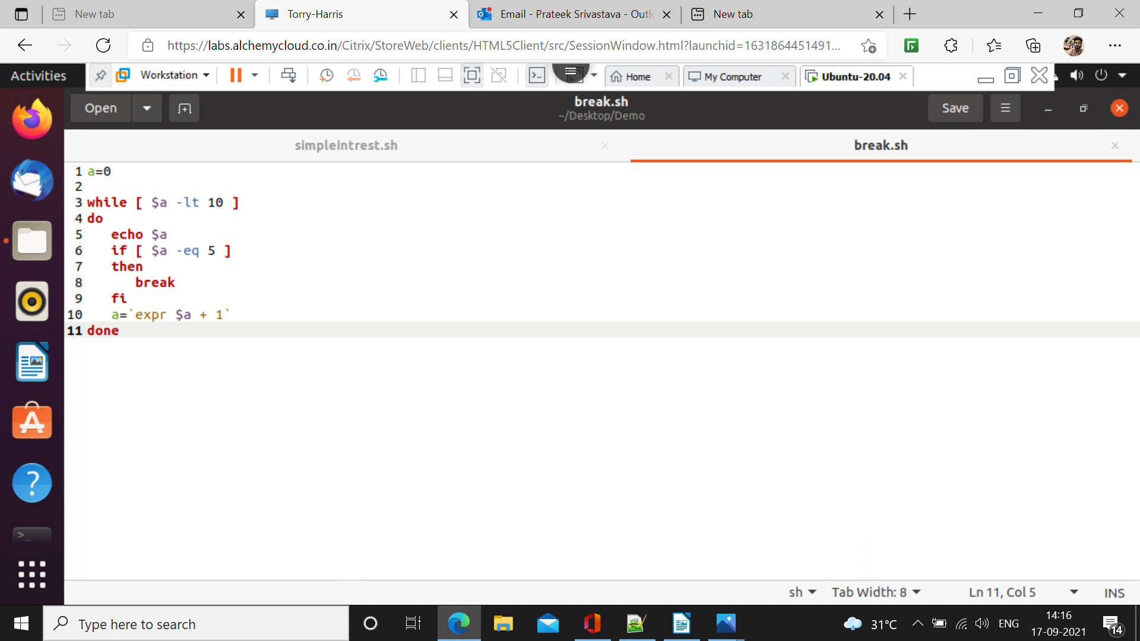
Execution-
a=0
while [ $a -lt 10 ]
do
echo $a
if [ $a -eq 5 ]
then
break
fi
a=`expr $a + 1`
done

Slide 4
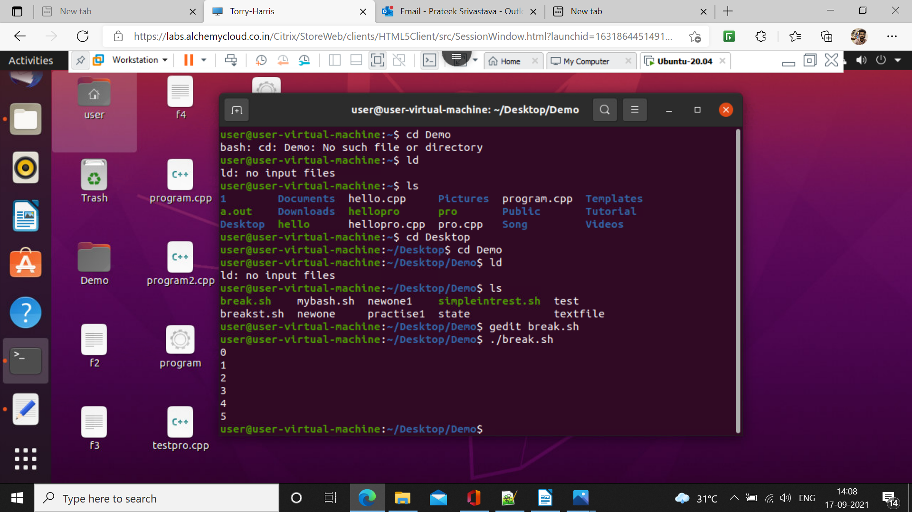
Output

